Slide 1
3D Printer Material Prediction Using IBM WATSON
PRESENTED BY:
TEAM NO: CSE-012
18UK1A0544 -Polu Ravichandra
18UK1A0563 - Ambati Akshaya
18UK1A0504 - Bairishetty Sahithi
18UK1A0526 - Jadala Karthik

Slide 2
OUTLINE
INTRODUCTION
OBJECTIVE
DATA
MACHINE LEARNING APPROACHES
VISUALIZATION OF GRAPHS
SOFTWARE REQUIREMENTS
CONCLUSION

Slide 3
INTRODUCTION
The 3D printing materials industry is increasing due to the rise in the demand from healthcare, automotive, and other industries, globally. The 3D printing materials market comprises several stakeholders, such as raw material suppliers, processors, end-product manufacturers, and regulatory organizations in the supply chain. The demand side of this market is characterized by the development of various industries such as aerospace & defense, healthcare, consumer goods, and automotive. Advancements in technology and diverse applications characterize the supply side. Various primary sources from both the supply and demand sides of the market were interviewed to obtain qualitative and quantitative information.
Predicting material would be more suitable for making the 3D model. In this project, the input parameters are like Layer Height (mm), Wall Thickness (mm), Infill Density (%), Infill Pattern (honeycomb, grid), Nozzle Temperature (Cº), Bed Temperature (Cº), Print Speed(mm/s), Fan Speed (%), Roughness (µm), Tension (ultimate), Strength (MPa), Elongation (%).
Based on these parameters a supervised machine learning model is built to predict the best material to be used for building 3D models. A web application is build so that the user can type in the mentioned parameters and the material which suits the best is showcased on UI.

Slide 4
OBJECTIVE
You’ll be able to understand the problem to classify if it is a regression or a classification kind of problem.
You will be able to know how to pre-process/clean the data using different data preprocessing techniques.
You will able to analyze or get insights into data through visualization.
Applying different algorithms according to the dataset and based on visualization.
You will be able to know how to build a web application using the Flask framework.

Slide 5
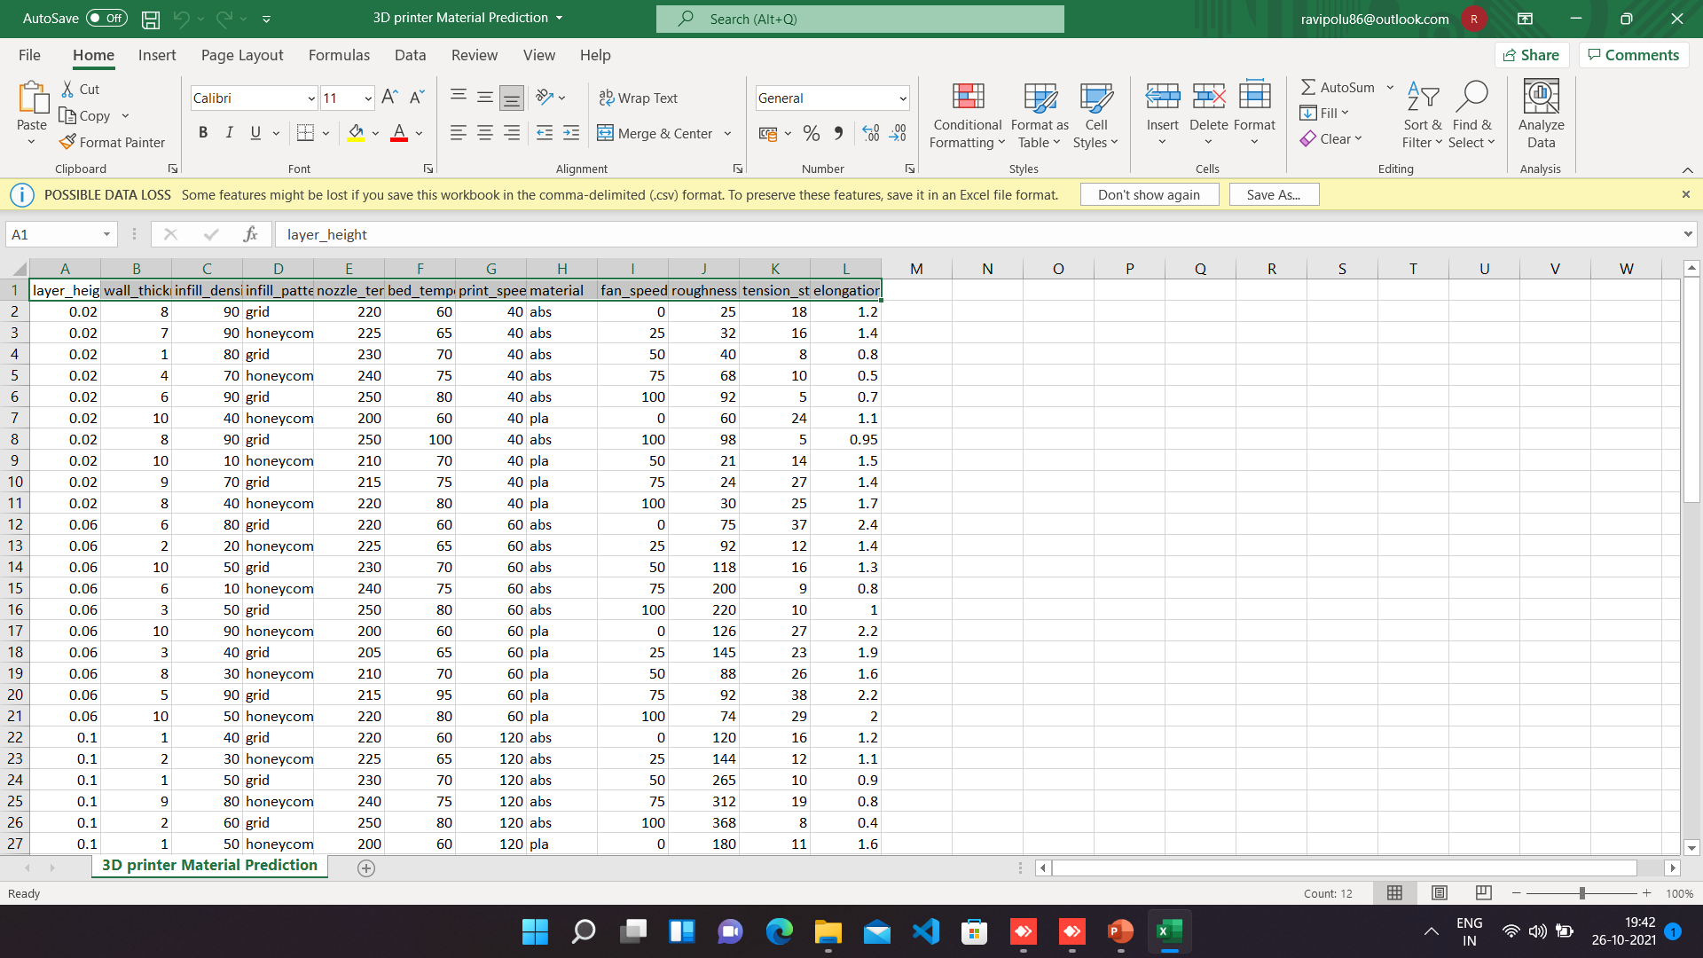
DATA
3D printer material dataset consists of:
67 rows with 12 columns
layer_height
wall_thickness
infill_density
infill_pattern
nozzle_temperature
bed_temperature
print_speed
material
fan_speed
Roughness
tension_strenght
elongation
Data source: Internet

Slide 6
DATA VISUALISATION
Data visualization is where a given dataset is presented in a graphical format. It helps the detection of patterns, trends and correlations that might go undetected in text-based data. Understanding your data and the relationship present within it is just as important as any algorithm used to train your machine learning model. Machine learning models will perform poorly on data that wasn’t visualized and understood properly.
To visualize the dataset we need libraries called Matplotlib and Seaborn. The Matplotlib library is a Python 2D plotting library that allows you to generate plots, scatter plots, histograms, bar charts etc.

Slide 7
MODEL BUILDING
There are several Machine learning algorithms to be used depending on the data you are going to process such as images, sound, text, and numerical values. The algorithms that you can choose according to the objective that you might have it may be Classification algorithms are Regression algorithms.
Example:
1.Linear Regression
2.Logistic Regression
3. Random Forest Regression / Classification.
4. Decision Tree Regression / Classification.
You will need to train the datasets to run smoothly and see an incremental improvement in the prediction rate.
On our Dataset , we have applied Decision Tree Regression / Classification.
to predict the Accuracy.

Slide 8
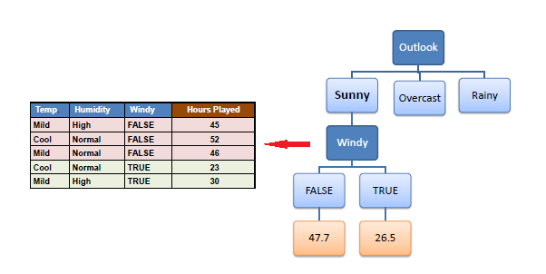
MACHINE LEARNING ALGORITHMS
Decision Tree Regression :
Decision Trees are a type of Supervised Machine Learning (that is you explain what the input is and what the corresponding output is in the training data) where the data is continuously split according to a certain parameter. An example of a decision tree can be explained using above binary tree.
Out of all the algorithms Decision Tree Regression got the highest accuracy .
So, We build a model with Decision Tree Regression.

Slide 9
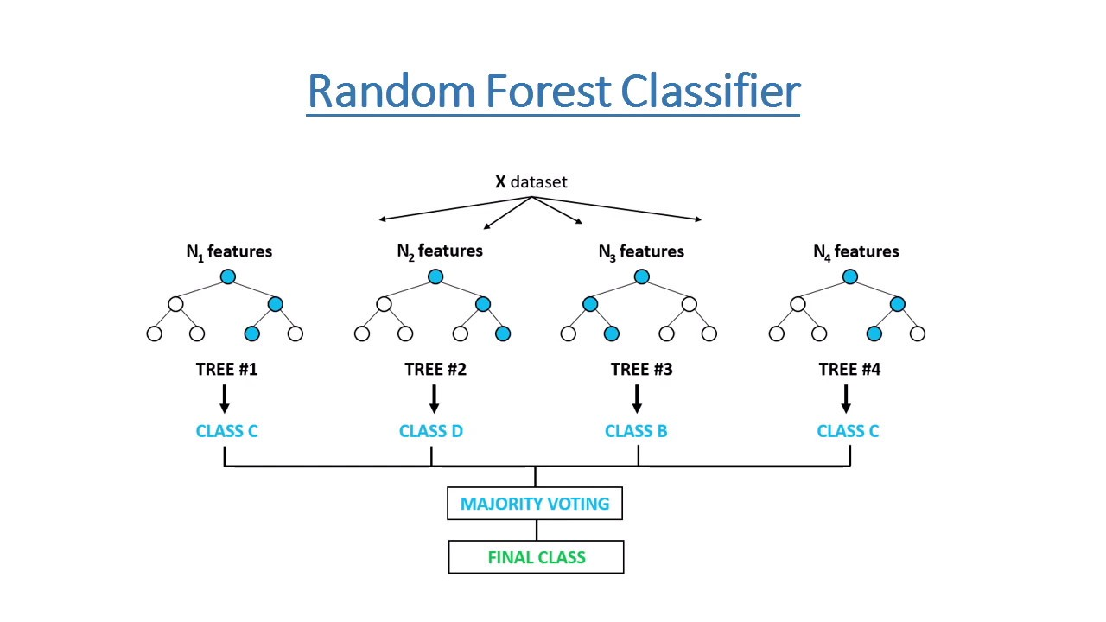
Random Forest :
A random forest is a machine learning technique that’s used to solve regression and classification problems. It utilizes ensemble learning, which is a technique that combines many classifiers to provide solutions to complex problems.
Working of Random Forest Algorithm
Step 1 − First, start with the selection of random samples from a given dataset.
Step 2 − Next, this algorithm will construct a decision tree for every sample. Then it will get the prediction result...
Step 3 − In this step, voting will be performed for every predicted result.
Step 4 − At last, select the most voted prediction result as the final prediction result.

Slide 10
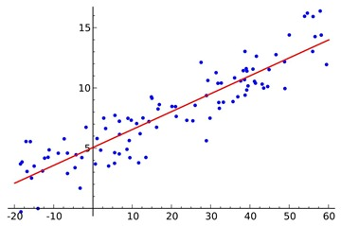
LOGISTIC REGRESSION:
Logistic regression is a supervised learning classification algorithm used to predict the probability of a target variable. The nature of target or dependent variable is dichotomous, which means there would be only two possible classes. ... Mathematically, a logistic regression model predicts P(Y=1) as a function of X.
Logistic Regression is used when the dependent variable (target) is categorical. For example,
To predict whether an email is a spam (1) or (0)
Whether the tumor is malignant (1) or not (0)

Slide 11
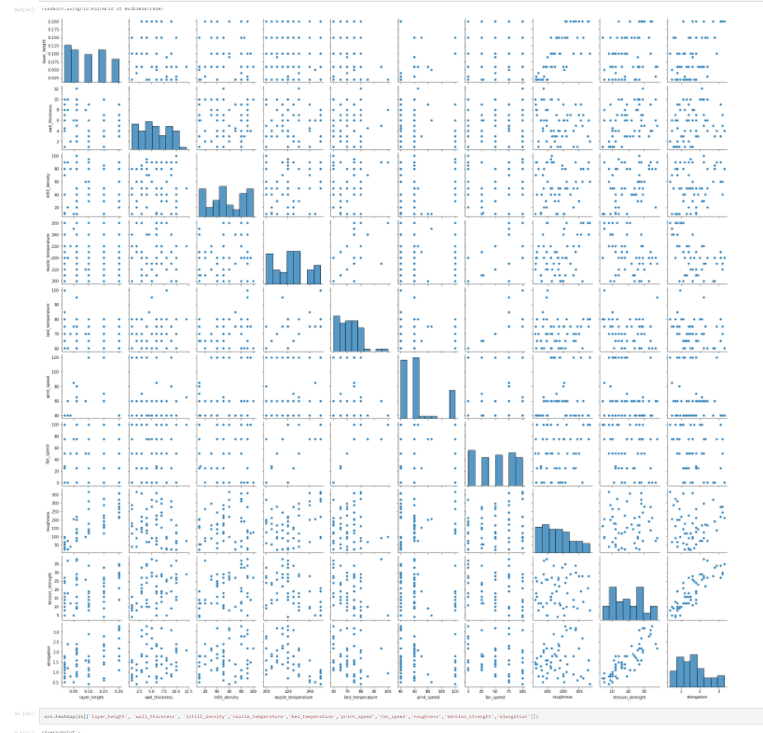
VISUALISATION OF GRAPHS
Pair plot usually gives pair wise relationships of the columns in the dataset From the above pair plot we infer layer_height,wall thickness,infill density ,Nfill patten ,Nozzle temperature ,Bed temperature ,Print speed Material, Fan speed ,Roughness, tension strenght elongation

Slide 12
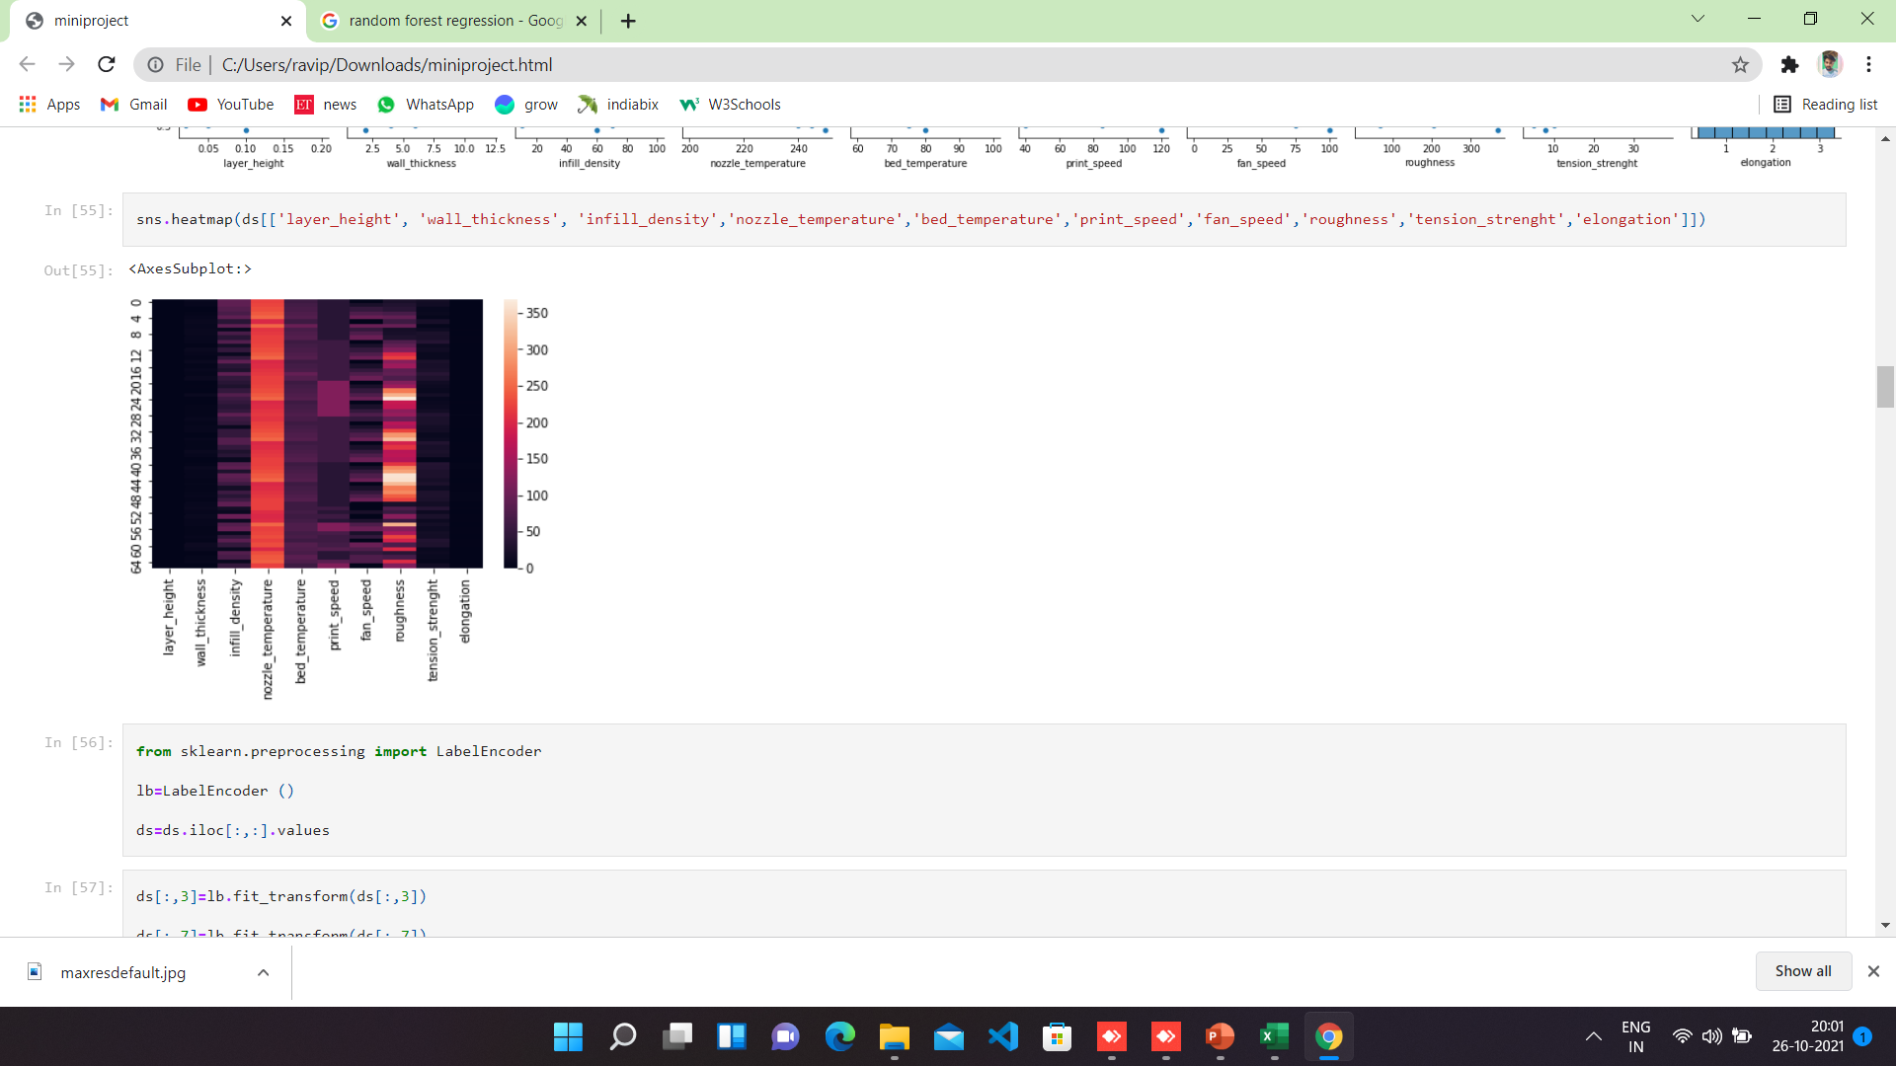
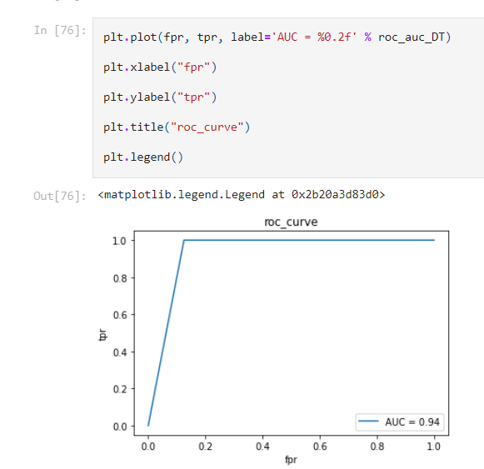

Slide 13
IBM WATSON STUDIO
IBM Acquired soft layer, a public cloud platform, to serve as the foundation for its IaaS offering. In October 2016, IBM rolled the soft layer brand under its Blue mix brand of PaaS offerings, giving users to access both IaaS and PaaS resources from a single console. IBM cloud provides a full-stack, public cloud platform with various products in the catalog, including options for compute, storage, networking, end to end developer solutions for app development, testing and deployment, security databases, and cloud native services.
We Created the IBM cloud account by going to the IBM cloud login page. Then we login to IBM Watson Studio and deployed our model on IBM.
Advantages of deploying model on CLOUD:
Security and privacy. Much like a private cloud, you can ensure your data remains secure when you are the only organization that uses the private portion of your infrastructure.
Potential cost savings.
Superior flexibility and scalability.

Slide 14
SOFTWARE REQUIREMENTS
Anaconda navigator
Jupyter notebook
Machine learning tools: pandas,
NumPy,
Matplotlib,
Scikitlearn,
Seaborn

Slide 15
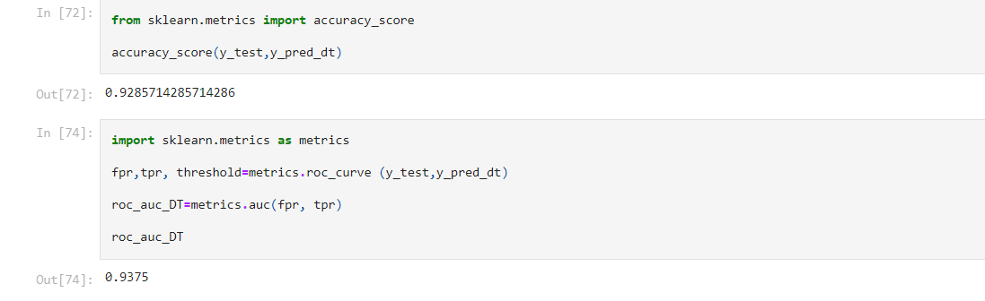
CONCLUSION
In this project we have presented the Prediction of 3D printer material.
We have done the Prediction using Machine Learning Techniques.
For the better results we used Decision Tree algorithm and proved with 93% accuracy.

